Slide 1
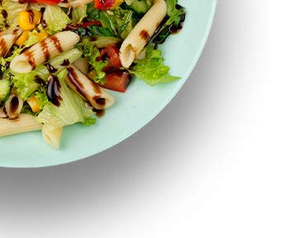
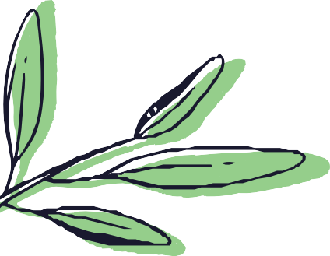
Spring & Summer Menu 2023
Croydon
 | Option | MONDAY | TUESDAY | WEDNESDAY | THURSDAY | FRIDAY
WEEK 1 | Main Option | Tomato Basil pasta Moong Dal & Rice Greens of the day | Jacket potato & Baked beans & cheese Kadhi & Vegetable rice Greens of the day | Burger & baby potatoes Rajma with Naan or Rice Greens of the day | Stir Fry Noodles Black Eye beans curry with Rice Greens of the day | Pizza & Chips Khichadi & yoghurt Greens of the day
 | Sides | Assorted Salads & Fruit Bread | Assorted Salads & Fruit Bread | Assorted Salads & Fruit Bread | Assorted Salads & Fruit Bread | Assorted Salads & Fruit Bread
 | Dessert | Fruit Yoghurt | Rice pudding | Cake | Apple Crumble & Custard | Ice cream
WEEK 2 | Main Option | Roasted Vegetable sauce & Pasta Yellow Dal & Rice Greens of the day | Hot dog & Baby potatoes Matar Paneer with rice or Naan Greens of the day | Vegetable Bake Idly Sambar Greens of the day | Quesadilla with corn on the cob Aloo Matar with Naan or Rice Greens of the day | Pizza & Chips Biryani rice Green of the day
 | Sides | Assorted Salads & Fruit Bread | Assorted Salads & Fruit Bread | Assorted Salads & Fruit Bread | Assorted Salads & Fruit Bread | Assorted Salads & Fruit Bread
 | Dessert | Fruit Yoghurt | Strawberry Jelly | Cake | Mousse | Ice cream
WEEK 3 | Main Option | Mac & Cheese Mix Dal & Rice Greens of the day | Mash Potato & Sausage & Gravy Chana Masala & Rice Greens of the day | Panini & Cheese Vegetable Curry with Naan or Rice Greens of the day | Chilli Beans Tacos & Mexican rice Cabbage Pea & Potato curry Greens of the day | Pizza & Chips Pilau rice Greens of the day
 | Sides | Assorted Salads & Fruit Bread | Assorted Salads & Fruit Bread | Assorted Salads & Fruit Bread | Assorted Salads & Fruit Bread | Assorted Salads & Fruit Bread
 | Dessert | Fruit Yoghurt | Pear Crumble & Custard | Brownie | Cinnamon puff | Ice cream
Allergens
D - Dairy | G - Gluten | S – Soja | Se – Sesame | Mu – Mustard | Ce - Celery
Please Note:
Salad bar, fresh breads & fruits are available every day; seasonal fruits and vegetables are used

